Slide 1

UE20CS390A – Capstone Project Phase – 1
Project Progress Review #3
Project Title : Voice Interface for PESU using AI
Project ID : PW23_PB_01
Project Guide : Prof. Priya Badrinath
Project Team with SRN : 805_806_826_844

Slide 2
Title of the Project
Abstract and Scope
Voice assistants use machine learning and natural language processing to respond to user requests.
The scope of a PESU voice assistant is vast and continues to expand as new use cases and functionalities are developed. The potential for voice assistants is limited
Easier access to PESU resources
Get The Latest Information about academics
Detect and respond to Owner Only
Tap talk and get wherever you wish in PESU academy
Personal voice assistant for students

Slide 3
Title of the Project
Suggestions from Review - 2
Suggestions and remarks given by the panel members.
Fetching from documents: We’re going to use Opencv for extraction of table information from ISA and any PDF into CSV
Voice training module :Natural Language Processing (NLP) will be used to convert normal language queries into database queries.
Voice Authencation : We’re going to use Gaussian Mixture Model-Universal Background Model (GMM-UBM) for voice Authentication

Slide 4
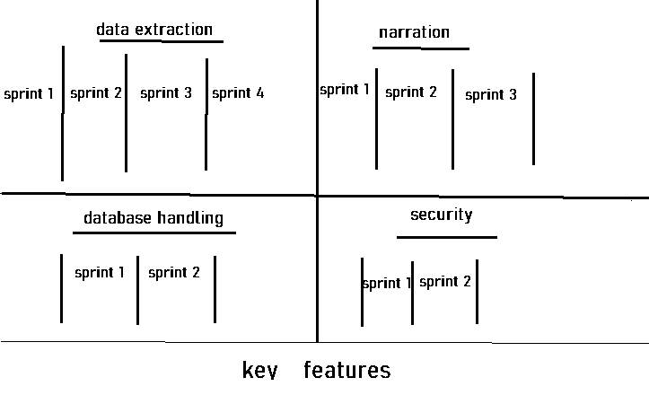
Title of the Project
We are following sequential and iterative design models in making of our AI trained voice assistant.
(this model will help us in making the software and launch of every sprint in sequential order)
Key features have been divided in four major components
Design Approach

Slide 5
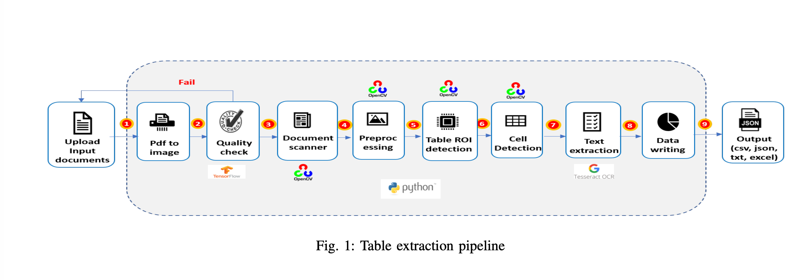
Title of the Project
Plan on execution of key features
Data extraction:
In Order to, Extract data from image Image has to be in good quality. That’s why we are using Logistic Regression to classify image as good or bad. Accuracy of Logistic Regression model was 83%
For Extraction of data from. We are going to use OpenCV and PYtesseract for text extraction from each cell.

Slide 6
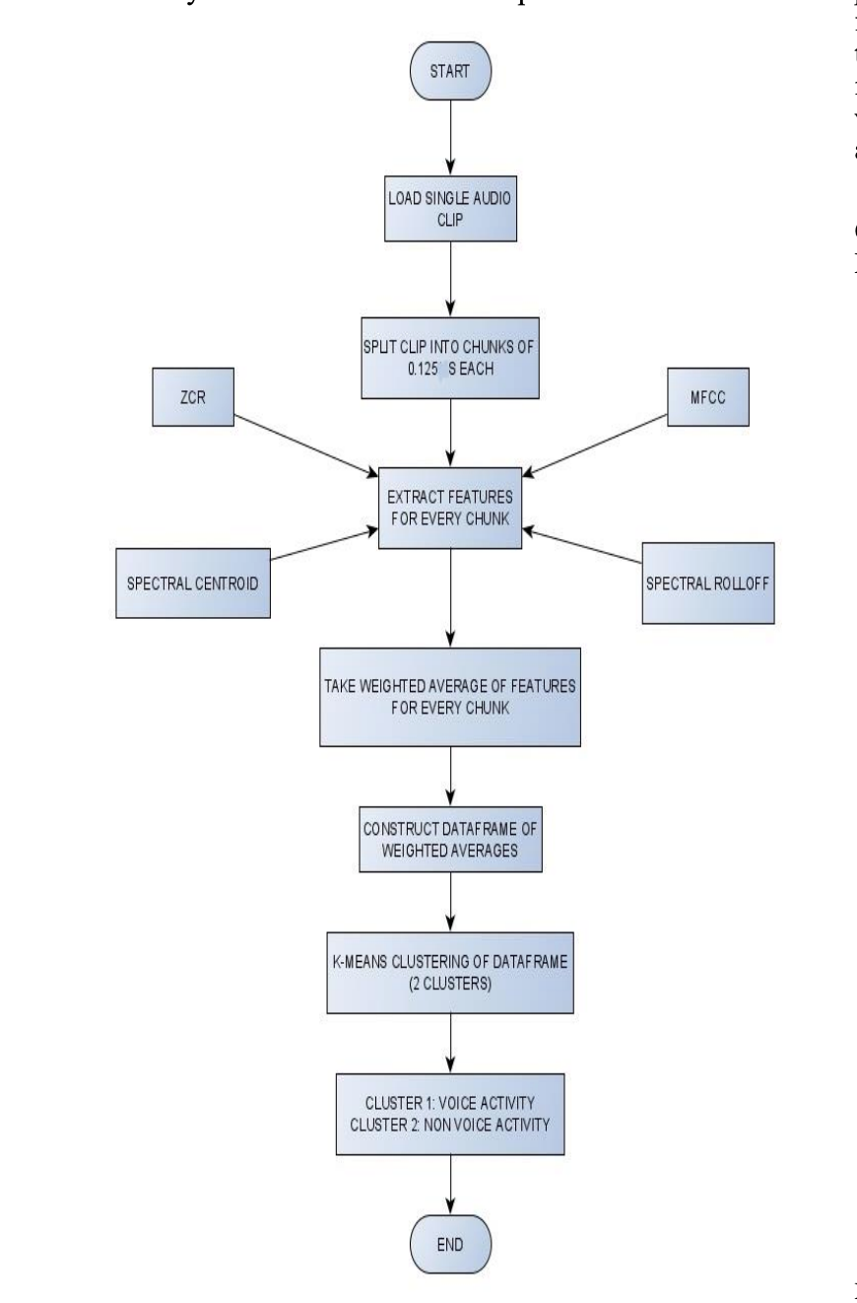
Title of the Project
Plan on execution of key features
Working model is simple, audio is broken down into .125 seconds clip, fed to feature extraction algorithm
Then, weights are added and passed to KNN, KNN classifies as human voice and non Human voice
Audio Features : -
Mel-Frequency Cepstral Coefficients
Spectral Roll – Off
Spectral Centroid
Zero Crossing Rate

Slide 7
Title of the Project
Plan on execution of key features
What do These Features tell us
The pitch of the sound: Spectral Centroid and MFCCs can help identify the pitch or fundamental frequency of the sound.
The timbre of the sound: MFCCs can help to identify the timbre or quality of the sound, such as whether it is a voice, a musical instrument or noise.
The rhythmic structure of the sound: Zero Crossing Rate can help to identify the rhythmic structure of the sound, such as how often it repeats.
The overall shape and texture of the sound: Spectral Roll-Off and Spectral Centroid can help identify the overall shape and texture of the sound, such as whether it has a lot of high-pitched or low-pitched frequencies.

Slide 8
Title of the Project
Voice Authentication of Students
Gaussian mixture models (GMM) : It involves modelling the probability distribution of the spectral features of a person's voice and comparing it to the distribution of known speakers.

Slide 9
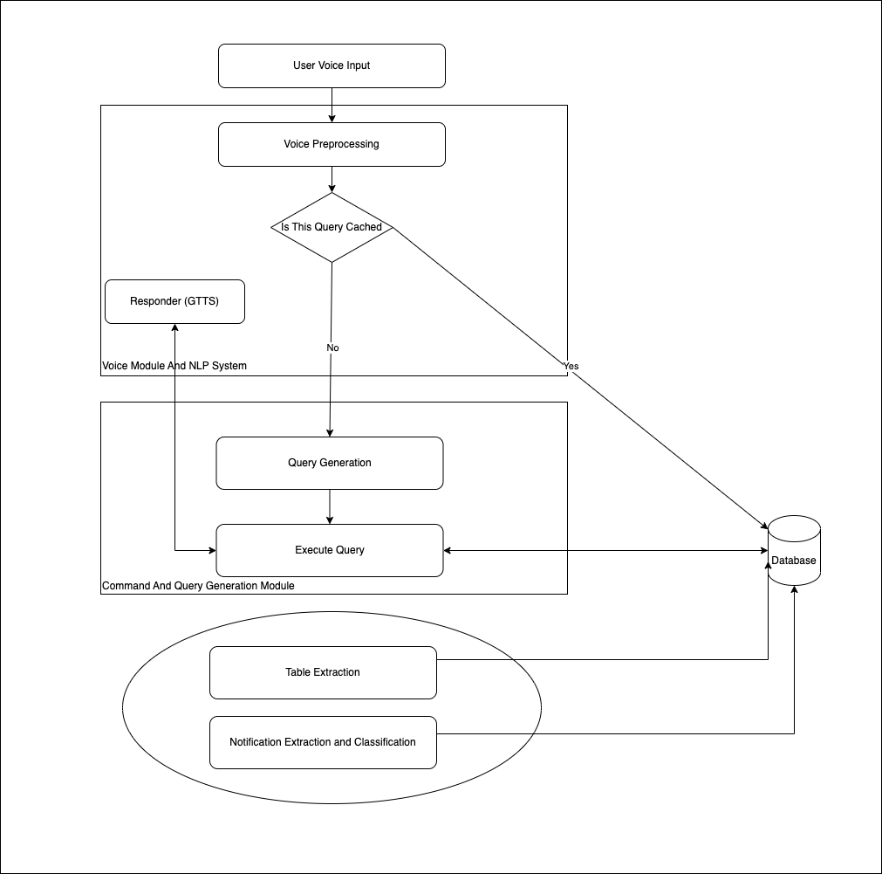
Title of the Project
Combining All Together

Slide 10
Converting Voice into Intents and Arguments : Natural Language Processing (NLP) will be used to convert normal language queries into database queries by leveraging various techniques such as : Tokenization Part-of-speech tagging Named entity recognition Query generation Query execution

Slide 11
Database handling : Data handling is important in ensuring the integrity of research data since it addresses concerns related to confidentially, security, and preservation/retention of research data. Proper planning for data handling can also result in efficient and economical storage, retrieval, and disposal of data. In the case of data handled electronically, data integrity is a primary concern to ensure that recorded data is not altered, erased, lost or accessed by unauthorized users. We are going to use pesu database so that all content is already encrypted , safe and secure

Slide 12
Security : For Encryption We are planning to use RSA Encryption Algorithm with SALTING

Slide 13
Title of the Project
Proposed Methodology / Approach
We are designing Different algorithms that will be used to make the AI assistant more user friendly and to make query generation via voice models easier.

Slide 14
Title of the Project
Design Description
Add as many slides as required to cover the following aspects:
Master class diagram
ER Diagram
User Interface Diagrams/ Use Case Diagrams
Report Layouts
External Interfaces

Slide 15
Title of the Project
Technologies Used
Python
Flask
OpenCV
Tessraract
PostgreSQL

Slide 16
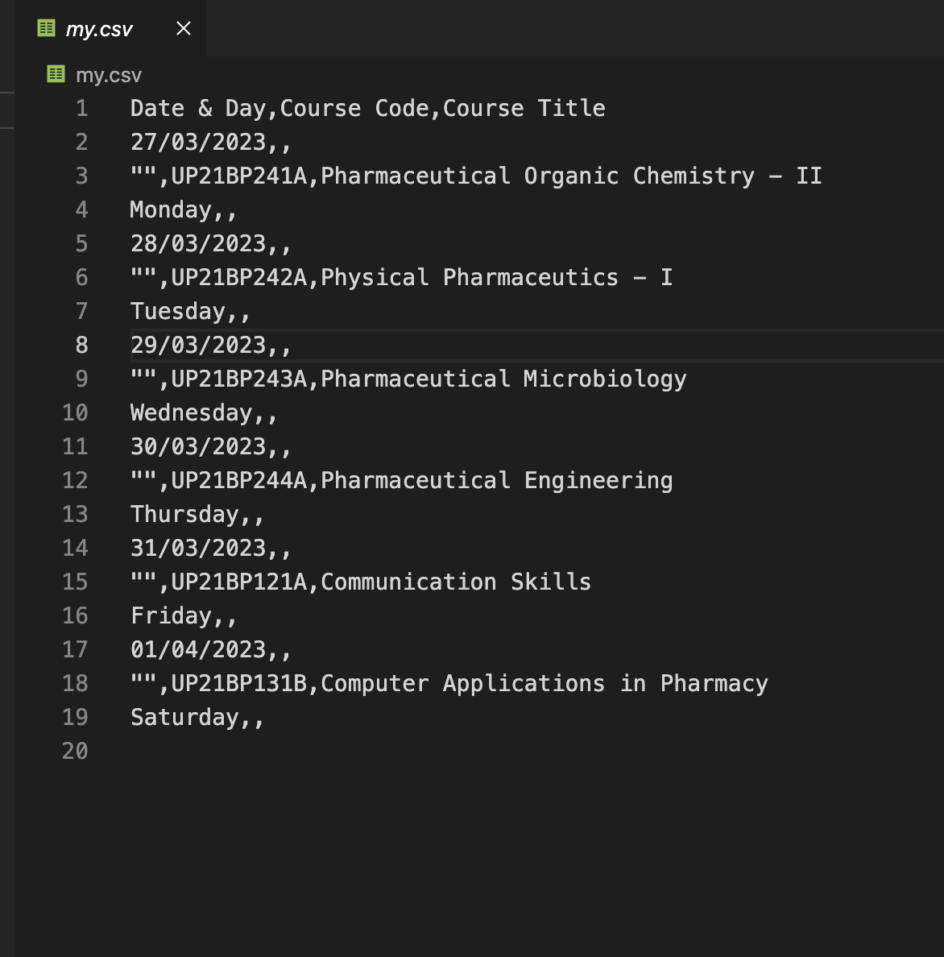
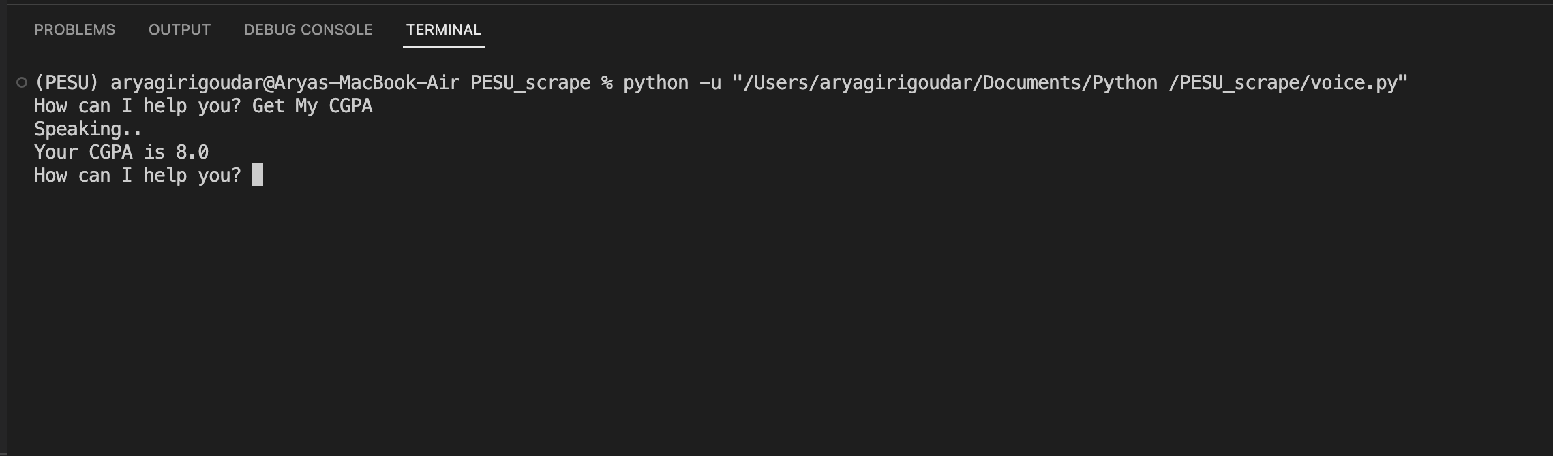
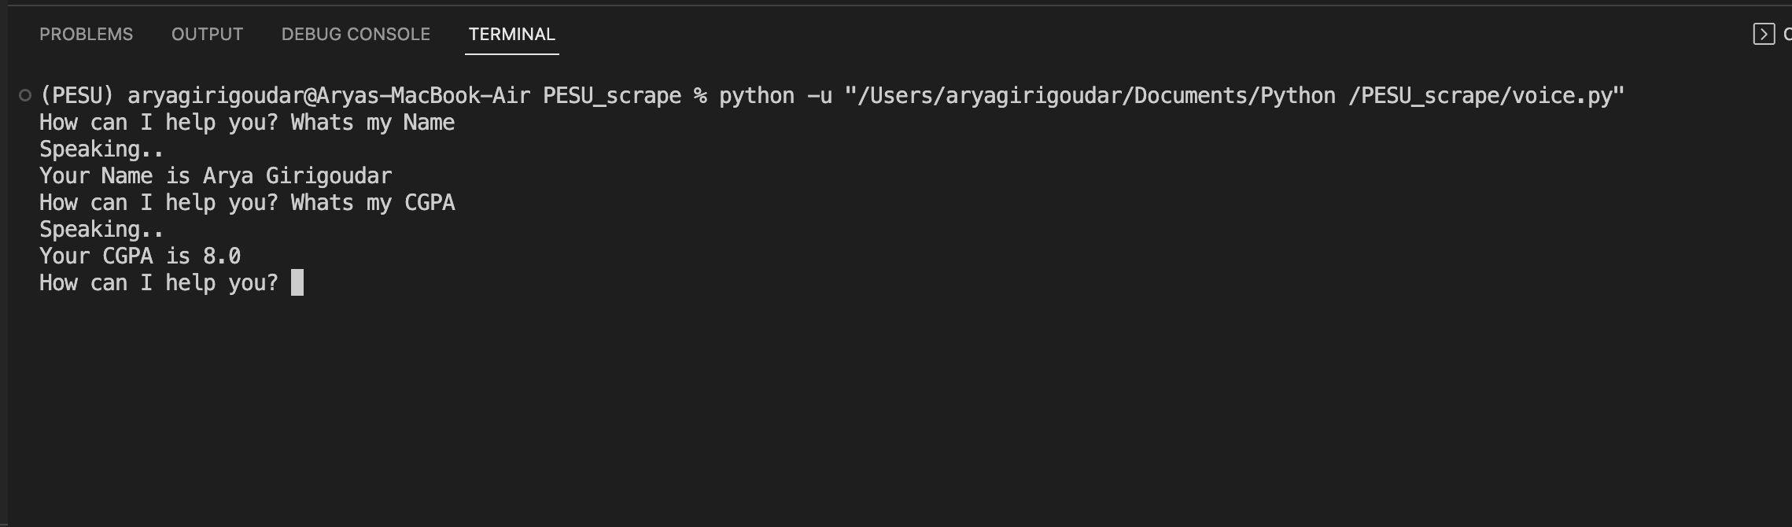
Title of the Project
Project Demo

Slide 17
Title of the Project
Project Progress
What is the project progress so far?
We have finalized what to use
We just have to improve our Algorithms to match our Level
What is the percentage completion of the project?
Roughly 40 %

Slide 18
Title of the Project
References
Provide references pertaining to your research according to IEEE format.
Example:
G. Eason, B. Noble, and I. N. Sneddon, “On certain integrals of Lipschitz-Hankel type involving products of Bessel functions,” Phil. Trans. Roy. Soc. London, vol. A247, pp. 529–551, April 1955. (references)

Slide 19
Title of the Project
Any other information
Provide any other information you wish to add on.
Note: Changes can be made in the template, with the consent of the guide for inclusion of any other information.

Slide 20
Thank You

